Slide 1
Introduction
ASP.NET Core 5 for Beginners (Customized)
Day-3
Notes:
20778C
1: Introduction to Self-Service BI Solutions

Slide 2
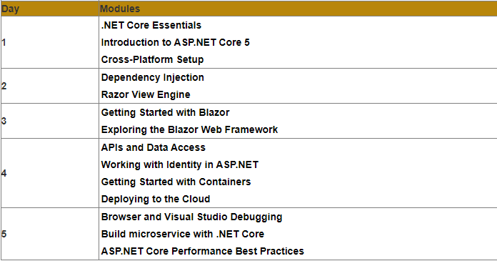
Modules
Notes:
20778C
1: Introduction to Self-Service BI Solutions

Slide 3
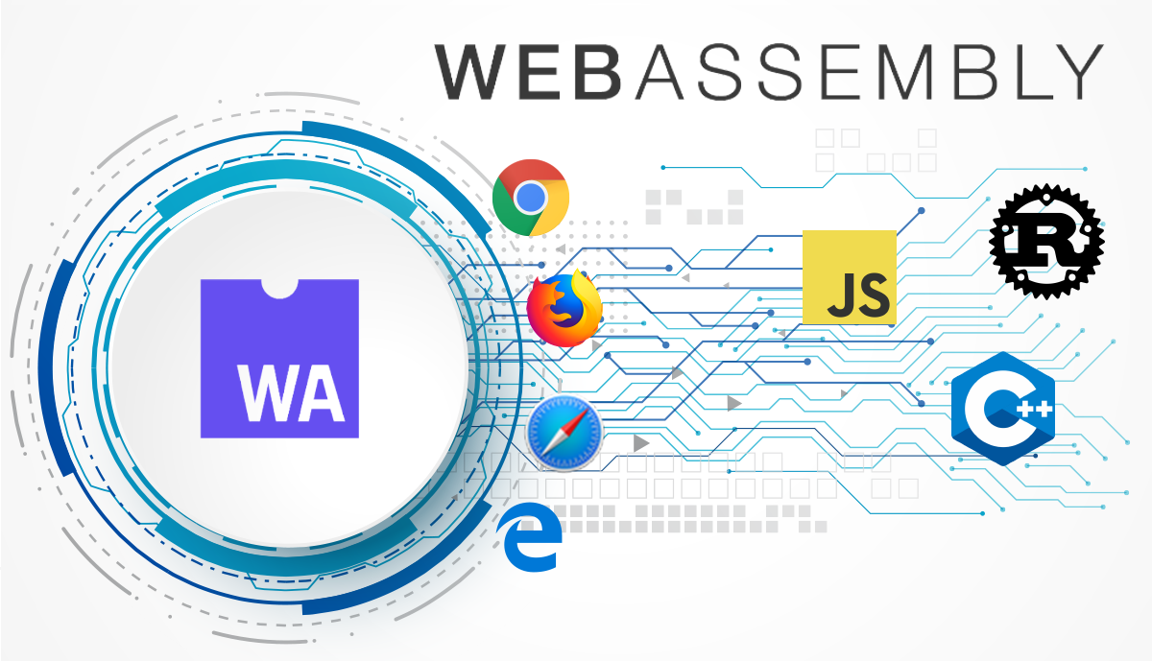
Blazor Client

Slide 4
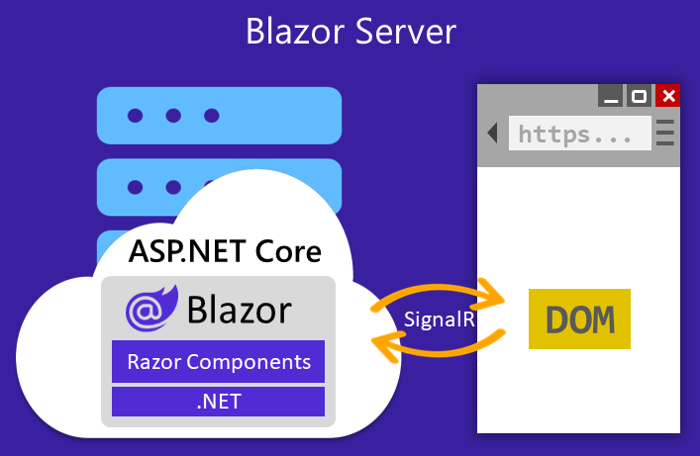
Blazor Server

Slide 5
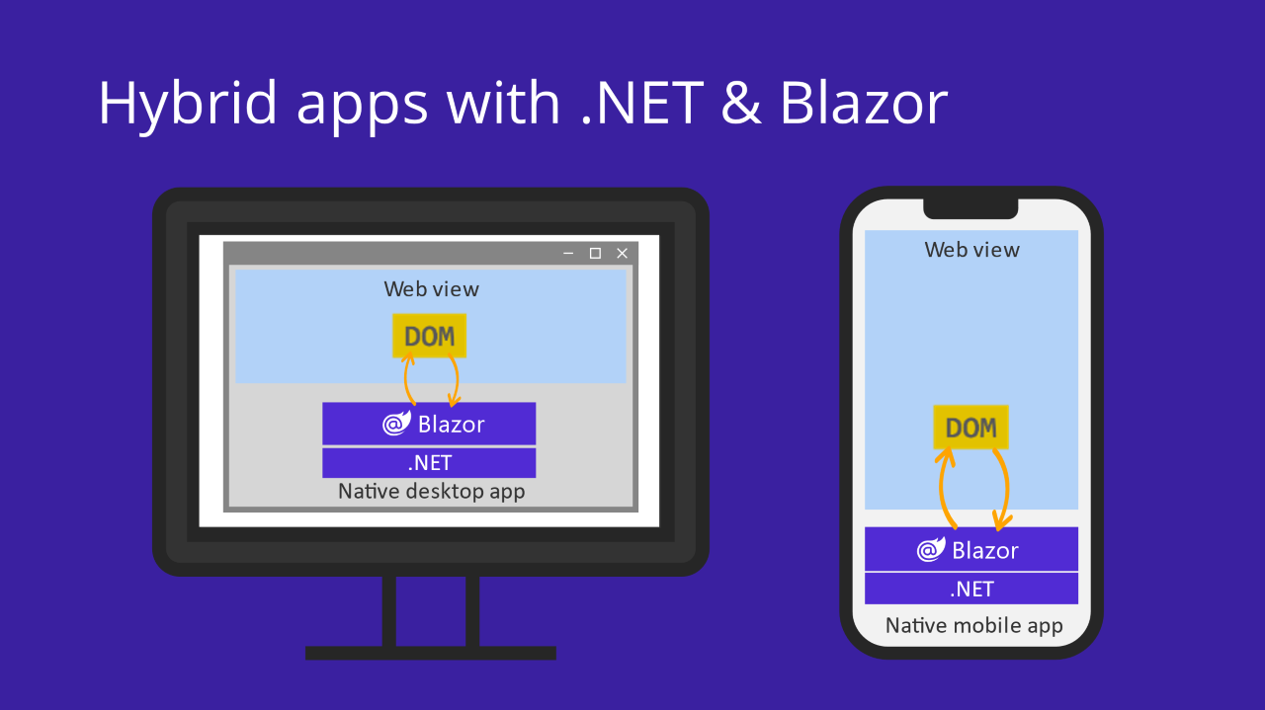
Hybrid App with .NET & Blazor

Slide 6
Comparison
Feature | Blazor Server | Blazor WebAssembly (WASM) | Blazor Hybrid
Complete .NET API compatibility | ✔️ | ❌ | ✔️
Direct access to server and network resources | ✔️ | ❌† | ❌†
Small payload size with fast initial load time | ✔️ | ❌ | ❌
Near native execution speed | ✔️ | ✔️‡ | ✔️
App code secure and private on the server | ✔️ | ❌† | ❌†
Run apps offline once downloaded | ❌ | ✔️ | ✔️
Static site hosting | ❌ | ✔️ | ❌
Offloads processing to clients | ❌ | ✔️ | ✔️
Full access to native client capabilities | ❌ | ❌ | ✔️
Web-based deployment | ✔️ | ✔️ | ❌
†Blazor WebAssembly and Blazor Hybrid apps can use server-based APIs to access server/network resources and access private
and secure app code.
‡Blazor WebAssembly only reaches near-native performance with ahead-of-time (AOT) compilation.

