Slide 1
Introduction
ASP.NET Core 5 for Beginners (Customized)
Day-2
Notes:
20778C
1: Introduction to Self-Service BI Solutions

Slide 2
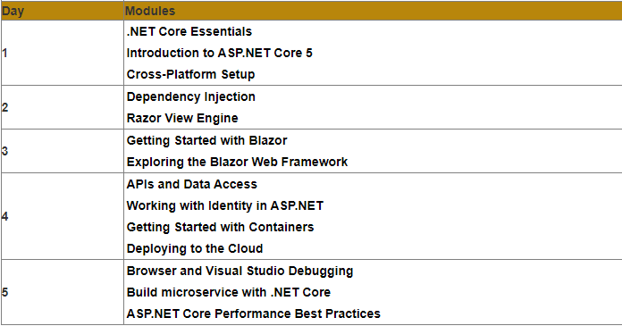
Modules
Notes:
20778C
1: Introduction to Self-Service BI Solutions

Slide 3
. Dependency Injection
Technical requirements
Learning dependency injection in ASP.NET Core
Reviewing types of dependency injection
Understanding dependency injection containers
Understanding dependency lifetimes
Handling complex scenarios
Notes:
20778C
1: Introduction to Self-Service BI Solutions

Slide 4
Razor View Engine
Technical requirements
Understanding the Razor view engine
Learning the basics of Razor syntax
Building a to-do application with MVC
Building a to-do app with Razor Pages
Differences between MVC and Razor Pages
Notes:
20778C
1: Introduction to Self-Service BI Solutions

