Slide 1
Introduction
ASP.NET Core 5 for Beginners (Customized)
Notes:
20778C
1: Introduction to Self-Service BI Solutions

Slide 2
Course Website
https://mswebdev.azurewebsites.net/ASPNETCORE0501

Slide 3
Your Instructor
LENG Chee Kong
ckleng1964@gmail.com
0192133329

Slide 4
Training Schedule
Duration: 5 Days Training Hours: 9am~5pm Lunch Break:
12:30pm~1:30pm (1 Hour)
Friday: Might be 2 Hours
Short Breaks:
Morning: 10:30am~10:45am
Afternoon: 3:30pm~3:45pm
Notes:
20778C
1: Introduction to Self-Service BI Solutions

Slide 5
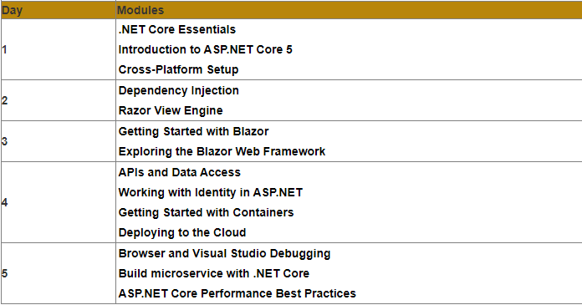
Modules
Notes:
20778C
1: Introduction to Self-Service BI Solutions

Slide 6
.NET Core Essentials
The different between .NET and .NET Core
NET Framework to create Windows desktop and server-based applications. This includes ASP.NET web applications. On the other hand, . NET Core is used to create server applications that run on Windows, Linux and Mac.
.NET Core does not currently support creating desktop applications with a user interface. Developers can write applications and libraries in VB.NET, C# and F# in both runtimes.
A cross-platform and open-source framework, .NET Core is best when developing applications on any platform. .NET Core is used for cloud applications or refactoring large enterprise applications into microservices.
Notes:
20778C
1: Introduction to Self-Service BI Solutions

Slide 7
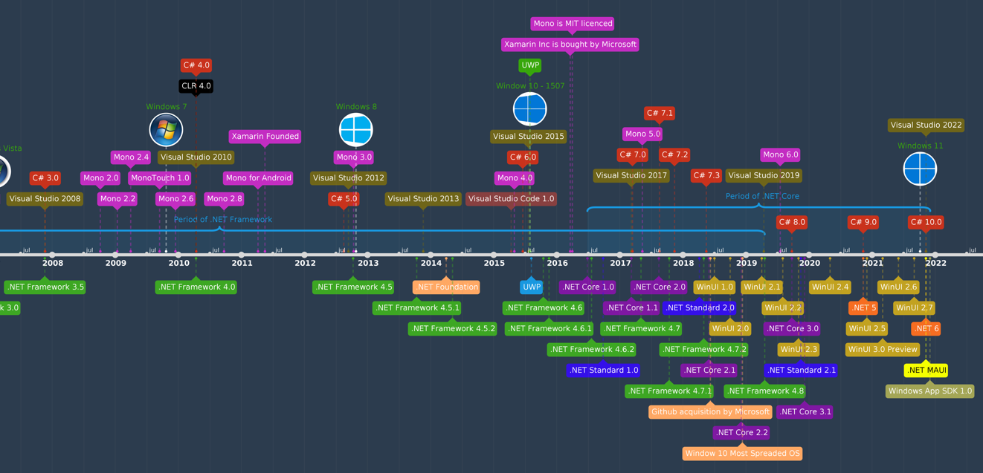
.NET Core Essentials
A brief history about .NET Core
https://time.graphics/pt/line/593132
Notes:
20778C
1: Introduction to Self-Service BI Solutions

Slide 8
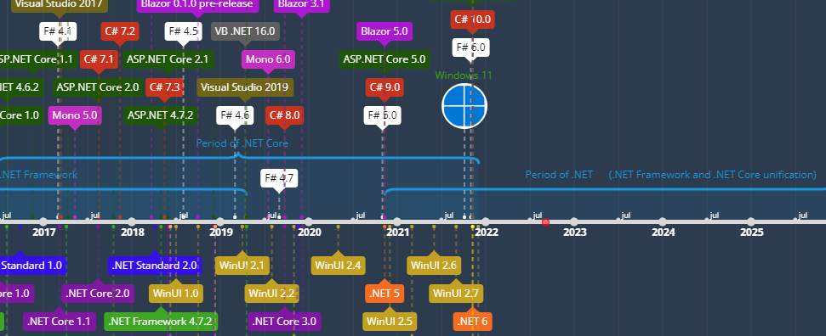
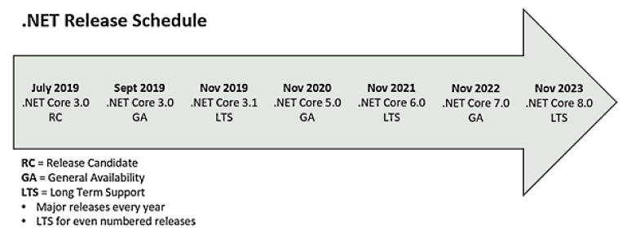
.NET Core Essentials
Coming version of .NET
Notes:
20778C
1: Introduction to Self-Service BI Solutions

Slide 9
.NET Core Essentials
The direction of .NET Core
The .NET Core platform provides significant performance benefits as compared to the traditional .NET Framework
.NET Core has been well-adopted outside Microsoft and benefits from strong community involvement
.NET Core benefits from a server-centric design that is not Windows-focused
.NET Core is now a stable platform suitable for new application development
(https://www.infoq.com/articles/future-of-net-core/)
Notes:
20778C
1: Introduction to Self-Service BI Solutions

Slide 10
Introduction to ASP.NET Core 5
Technical requirements
Explaining ASP.NET Core
Refreshing your C# knowledge
Understanding websites and web servers
Exploring the IDE
Notes:
20778C
1: Introduction to Self-Service BI Solutions

Slide 11
Introduction to ASP.NET Core 5
Technical requirements
Basic Knowledge and skill in C#, or other related .NET language
Basic knowledge of N-Tier architecture
Knowledge of HTML
Notes:
20778C
1: Introduction to Self-Service BI Solutions

Slide 12
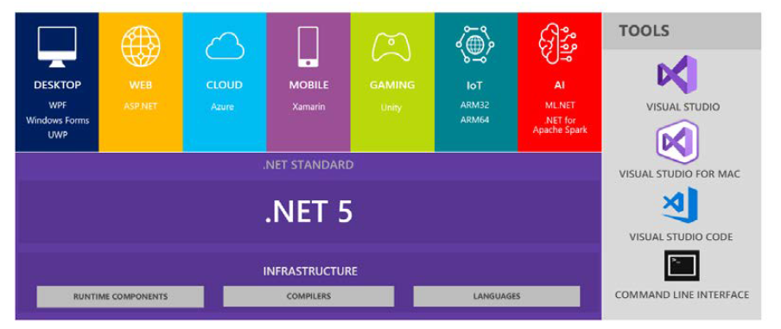
Introduction to ASP.NET Core 5
Explaining ASP.NET Core
The main purposes of .NET
The pressure from Open-Source and Java
Consolidating many old technologies of Microsoft
Support OOOS
Managed versus unmanaged code
Introducing the .NET platform
Notes:
20778C
1: Introduction to Self-Service BI Solutions

Slide 13
Introduction to ASP.NET Core 5
Refreshing your C# knowledge
Generalization
Inheritance
Specialization
Polymorphism
Interface
Delegate
Anonymous Delegate
Lambda Expression
Property
Nullable Type
Struct Vs Class
Reference Equality Vs Value Equality
Why Nullable is needed?
Asynchronous Programming
Notes:
20778C
1: Introduction to Self-Service BI Solutions

Slide 14
Introduction to ASP.NET Core 5
Understanding websites and web servers
Client-Server Model
TCP/IP Network Protocol
HTTP Service Protocol
ASP.NET, ASP.NET MVC and WebAPI
An ASP.NET Core app is a console app that must be started when a server boots and restarted if it crashes. To automate starts and restarts, a process manager is required. The most common process managers for ASP.NET Core are:
Windows
IIS
Windows Service
Linux
Nginx
Apache
An ASP.NET Core can be hosted on Azure could Docker and Web Farm too
Notes:
20778C
1: Introduction to Self-Service BI Solutions

Slide 15
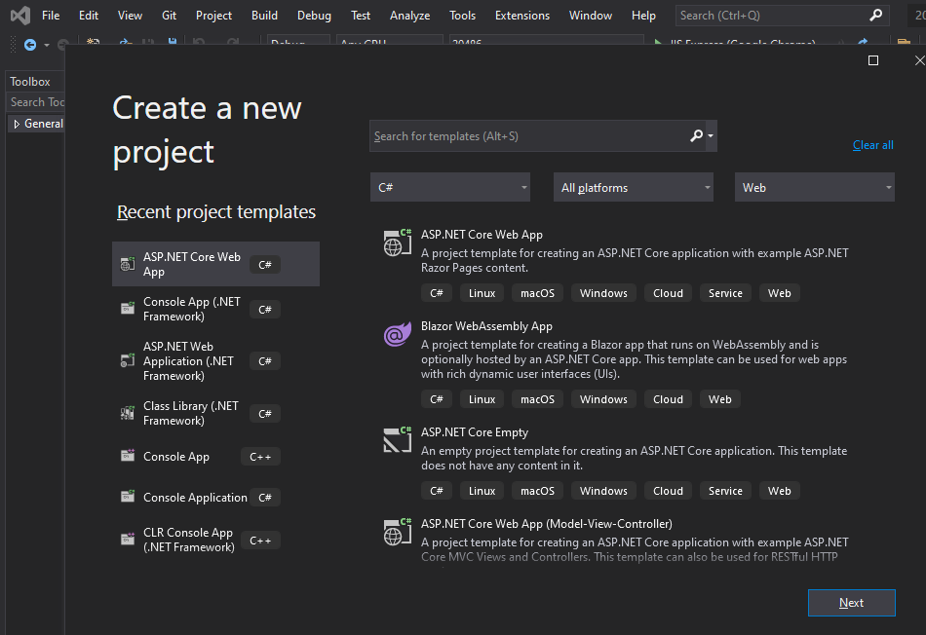
Introduction to ASP.NET Core 5
Exploring the IDE
Building your first ASP.NET Core 5 project
Notes:
20778C
1: Introduction to Self-Service BI Solutions

Slide 16
Cross-Platform Setup
Technical requirements
Leveraging the .NET Framework
Getting started on Windows, Linux, and macOS
Debugging Linux on Windows with Visual Studio 2019
Notes:
20778C
1: Introduction to Self-Service BI Solutions

Slide 17
Cross-Platform Setup
Technical requirements
To experience in running code on different operating systems, so if you want to test all the options, you will need several devices:
The code for Windows and Linux will work on a Windows computer.
The code for macOS requires a Mac system.
The code for Windows can run on a Mac if you use Fusion/Parallels or Bootcamp
In addition to the devices, you will also need the following:
Visual Studio Code, which is available for Windows, Linux, and macOS
Visual Studio 2019, which is available for Windows and macOS
Notes:
20778C
1: Introduction to Self-Service BI Solutions

Slide 18
Cross-Platform Setup
Leveraging the .NET Framework
.NET was not present from the beginning of Windows, and it had its own growing pains over the years.
Fast forward to modern times, and Microsoft will be more than happy to tell you how great Linux runs on their cloud computing platform and will provide you with everything you need in order to make .NET code run on the Linux operating system.
It took 20 years to turn the ship around, but it certainly is a different path being taken these days. Let's first see why we should go cross-platform and when we shouldn't go cross-platform.
Notes:
20778C
1: Introduction to Self-Service BI Solutions

Slide 19
Cross-Platform Setup
Leveraging the .NET Framework
Why cross-platform?
You have the .NET 5 SDK that you need to develop .NET applications. The fact that this works on macOS means that developers do not need a Windows computer to develop software for Windows, and since Macbooks are popular in the tech community, this broadens the potential developer audience for .NET.
You also have the .NET runtime that is required for running .NET applications. The fact that this works on Linux means that you are not forced to run your applications on Windows, and for servers this is a big thing. With a classic Windows Server with a UI running Internet Information Services, the operating system alone takes up multiple gigabytes of space. A trimmed down Linux installation, with a command line, could be as little as 50 megabytes. If you want to run cloud-native apps, this is a major win.
Notes:
20778C
1: Introduction to Self-Service BI Solutions

Slide 20
Cross-Platform Setup
Leveraging the .NET Framework
Why not cross-platform?
Native and unmanaged code is still required for some applications, and then cross-platform might not be the best option for those situations. For instance, in the early days of iPhones, there was no flashlight app, but some clever people figured out that they could interact with the camera and use the flash as a flashlight.
This was before Xamarin was a viable option, but it is likely this would have been outside the scope of .NET managed code to implement it.
Notes:
20778C
1: Introduction to Self-Service BI Solutions

Slide 21
Cross-Platform Setup
.NET cross-platform availability
So, when we say cross-platform, do we mean every platform out there? No, not really, but there are quite a range of options:
Windows x86/x64/ARM: ARM is not widely available from OEMS, but Microsoft has the Surface Pro X device that runs Windows on ARM. Note that not all the regular Windows apps are available on this platform, so even though there are emulation options, your mileage may vary.
macOS
Linux
iOS (through Xamarin)
Android (through Xamarin)
Notes:
20778C
1: Introduction to Self-Service BI Solutions

Slide 22
Cross-Platform Setup
Getting started on Windows, Linux, and macOS
Windows - We touched upon getting started with .NET 5 on Windows in the previous module, so you should already have a functioning setup for this platform if you followed that guide. Hence, we will not repeat those instructions here.
Linux - Linux is a popular operating system for server workloads, and it powers a large number of the virtual machines that run in Azure. It is not as popular as Windows for the average end user on their desktop, but for a developer, there are a number of benefits to using Linux. When developing microservices that run in containers, Linux is a good choice since, in many cases, you will be able to run trimmed-down images.
macOS - There are two main tools you can use for developing a .NET application on a Mac. You can either use Visual Studio for Mac or Visual Studio Code.
Notes:
20778C
1: Introduction to Self-Service BI Solutions

Slide 23
Cross-Platform Setup
Getting started on Windows, Linux, and macOS
ASP.NET Core for Linux Setup
Windows Subsystem for Linux (WSL)
Installing .NET on Linux
ASP.NET Core for macOS Setup
Notes:
20778C
1: Introduction to Self-Service BI Solutions

Slide 24
Cross-Platform Setup
Debugging Linux on Windows with Visual Studio 2019
Notes:
20778C
1: Introduction to Self-Service BI Solutions

